Slide 1

Digital Music Store Investigation

Slide 2
Most popular music Genre for each Country
We can see that Rock is the most popular music genre in the World.
USA has the largest Rock purchasing. So, It’s a good idea if we want to make a marketing campaign in USA in those years to be related to Rock genre music.
After Canada and Brazil, no other country purchase even close to the amount of the USA.

Slide 3
The music Genre purchases at USA in 2013
Around 70% of the USA purchases in 2013 (last year of the purchases invoces) is Rock and Metal.
It’s so interesting that Rock is still the most popular music Genre at USA in 2013.

Slide 4
Top 10 Rock bands in USA
We can see that U2 is the most Productive and populer Rock band in USA.
Deep purple ,Iron Maiden and Led zeppelin are also a good chooses in addition to U2 for us if we want to make a marketing campaign for any product in USA in those years

Slide 5
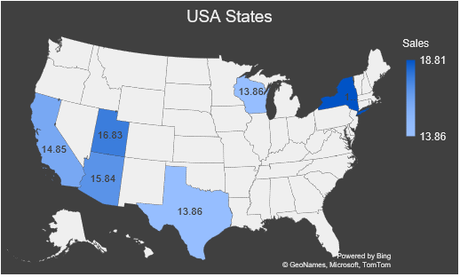
States spend more than average sales in Rock music
We can see that New York is the most Rock music spend state in the USA.
Even if New York has the top spend value, it’s better to choose Utah ,Arizona or California if we want to make Rock concert or marketing campaign as we will get benefit of there geographical Neighborhood.
Wisconsin
18.81
New York
California
Utah
Arizona
Texas

